Slide 1



A Mini Project Presentation on “Electronic waste recycling program”
Presented by:
Rakshita Mathod(2JR20CS065) Rakshita Halaj (2JR20CS066)
Rashmi Mithare(2JR20CS067) Richa Shinde (2JR20CS068)
Under the Guidance of:
Prof. Iranna Amargol
Jain College of Engineering & Research, Udyambag, Belagavi
Department of Computer Science and Engineering

Slide 2
Contents
Introduction
Objective
Literature Survey
Existing & Planned System
Block Diagram
Output
References
2

Slide 3
Introduction
In today's digital age, electronic devices have become an integral part of our lives. From smartphones and laptops to televisions and household appliances. However, the rapid growth of technology has also given rise to a pressing issue: electronic waste, commonly known as e-waste.
The proposed system combines advanced technologies, responsible practices, and collaborative efforts to ensure the safe disposal and reuse of electronic devices, there by minimizing their negative impact on the environment and human well-being.
The system ensures that any e-waste that cannot be recycled or refurbished is disposed of responsibly. It adheres to guidelines for the safe disposal of e-waste materials, preventing their release into the environment and minimizing.
3

Slide 4
Objective
Develop a Mobile and Web-based application that offers a proper disposal of E-Waste.
The primary objective is to protect the environment from the harmful effects of e-waste.
The recycling of e-waste serves a lot of useful purposes. For instance, include protecting human and environmental health by keeping those devices out of landfills.
Or recovering the parts within the devices that still have value, and providing manufacturers with recycled metals that can be used to make new products.

Slide 5
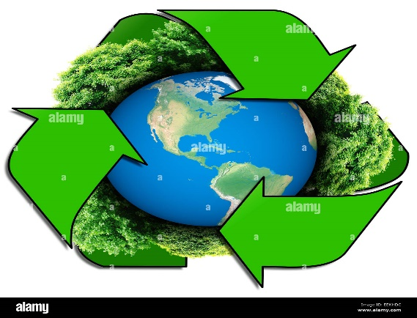
Literature Survey
Prachi N. Kare E-Waste Management Initiatives of Government Volume 08, Issue 05(May 2020)
Android is now the most used mobile operating system in the world. Android now has more users, more phones and more tablets worldwide than any other mobile operating system. The Google Play app store has been growing at breakneck speed and with almost as many apps as the Apple app store.
Monika and Jugal Kishore Indian J Community Med ,Issue on 2019.
Rama Mohana ,R Turaga and Kalyan Bhaskar E-Waste Management in India: Issues and Strategies ,Issue on 2019.
4

Slide 6

Existing and Planned systems
The Waste Collection system is offline which is done by government. We are define the new system online e-waste collection system.
The waste collection system is now on online waste collection website. The public get the information about the e-waste material .
The recycling waste will be used in other equipment’s and industries can use the recycling equipment’s for new material.
To reuse electronic waste material by recycling .
6

Slide 7
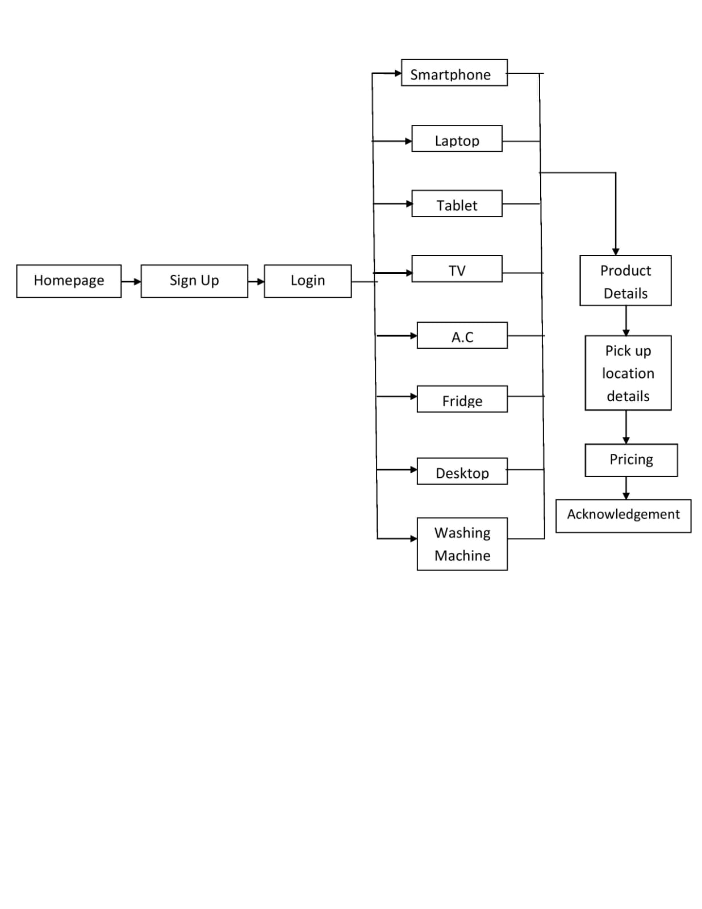
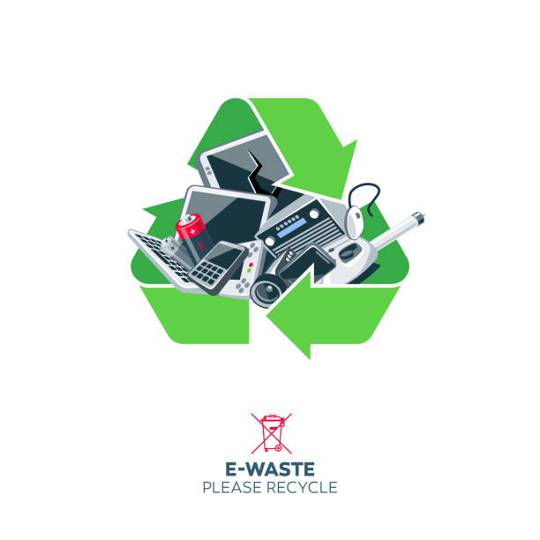
Block Diagram
7

Slide 8
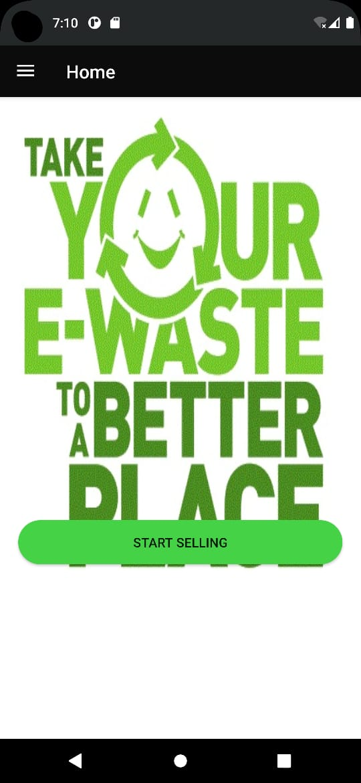
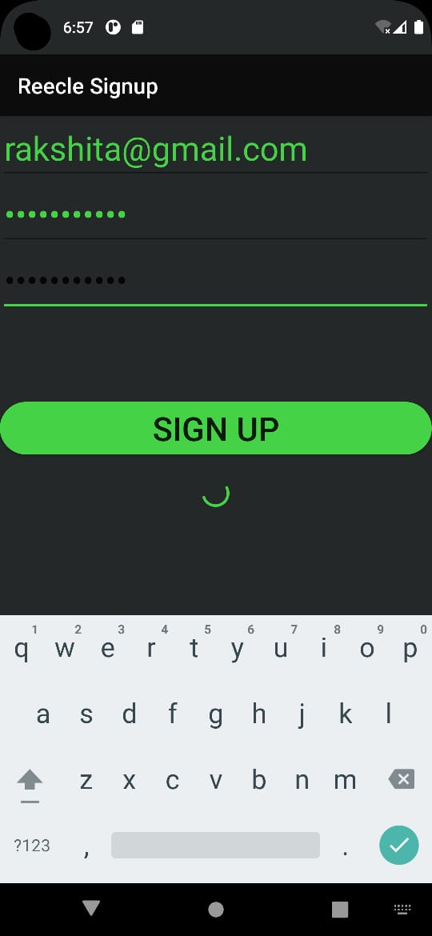
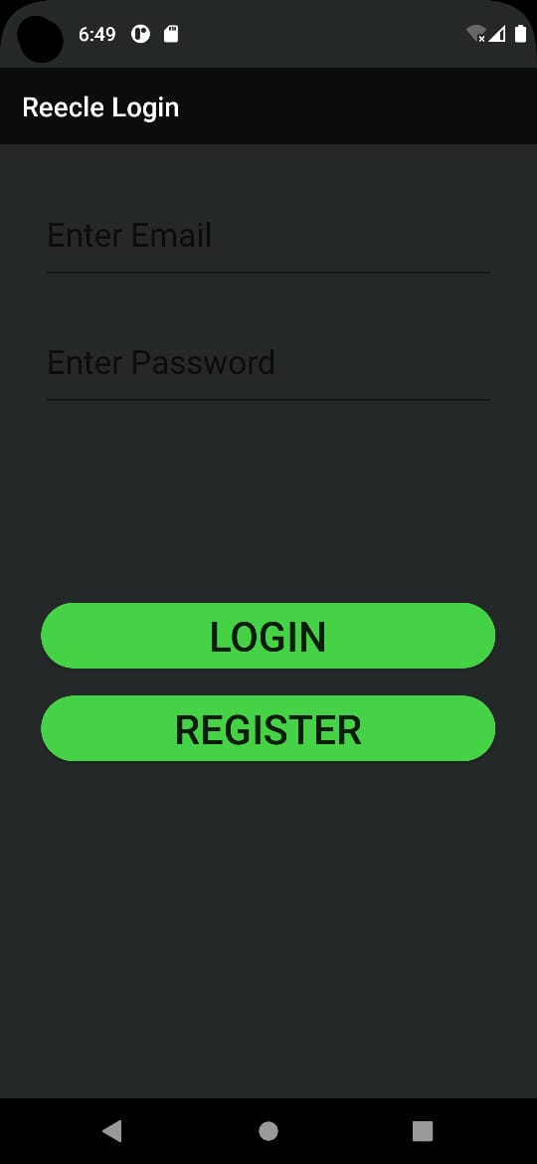
Screenshot Of Output

Slide 9
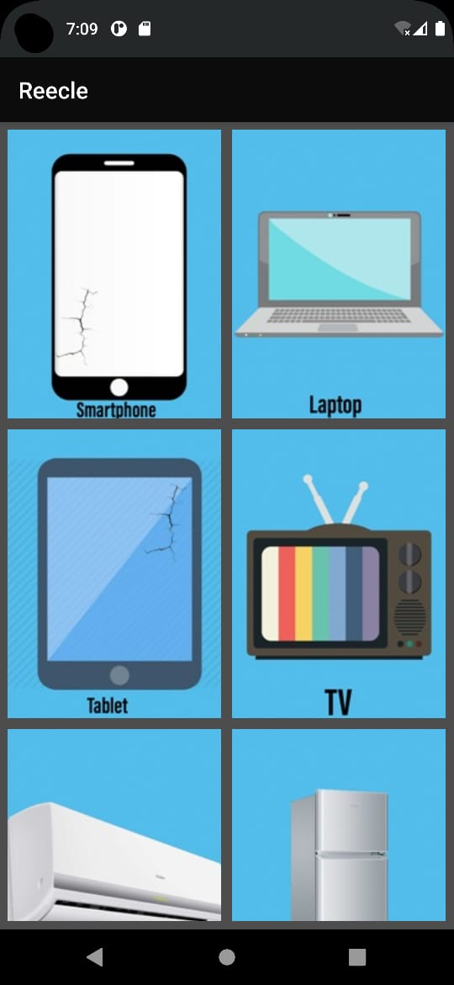
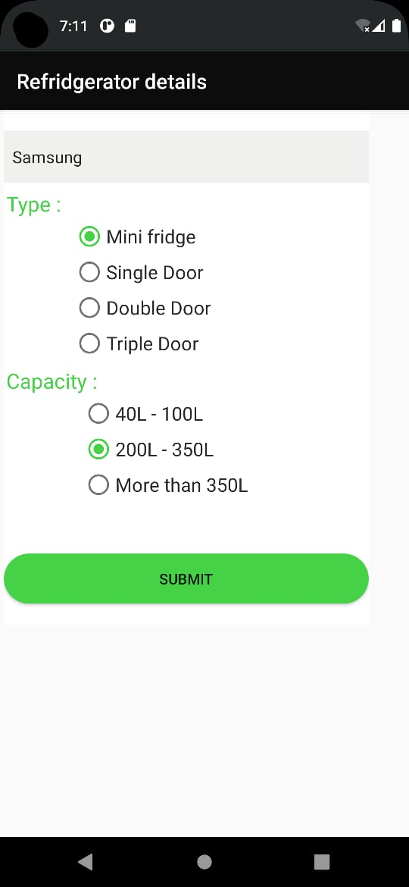
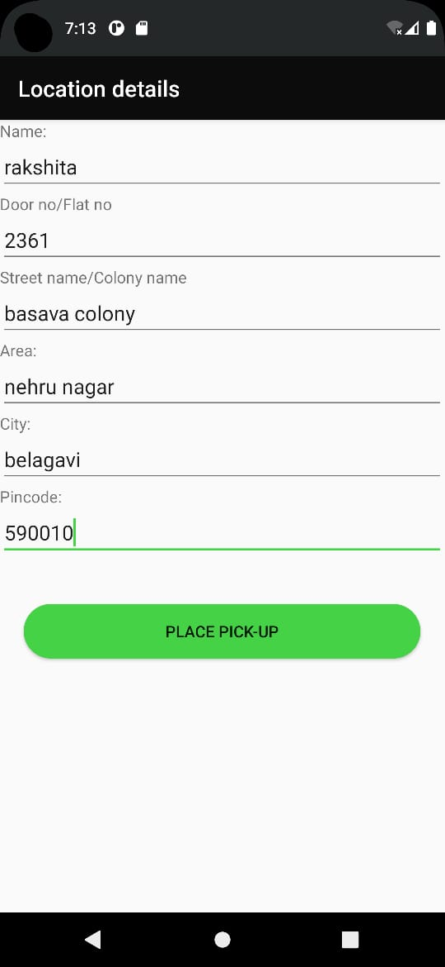
Screenshot Of Output

Slide 10
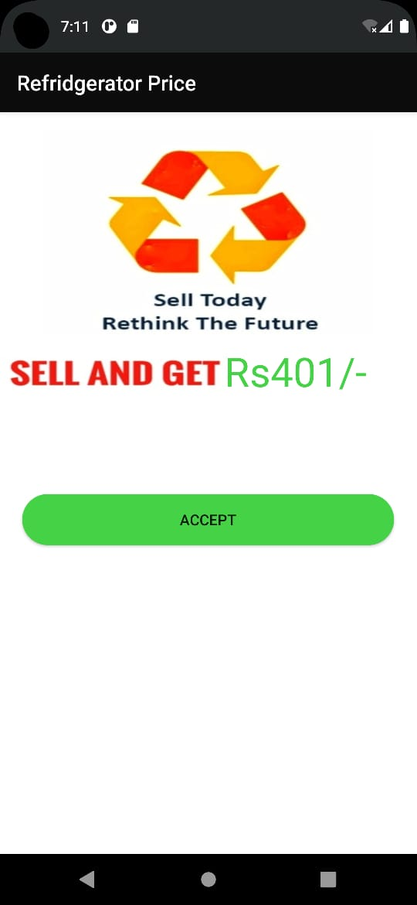
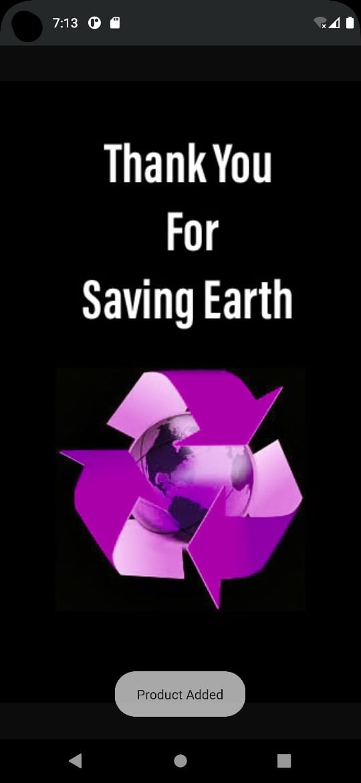
Screenshot Of Output

Slide 11

References
A report on “Managing Electronics Waste (2007). Dumping old TV, First read the rule”, The Hindustan Times, New Delhi Edition, 15 October, p.1.
S. Chatterjee and Krishna Kumar (2009). “Effective electronic waste management and recycling process involving formal and non-formal sectots”.
Informal electronic waste recycling: A sector review with special focus on China Xinwen Chi a, Martin Streicher-Porte b, Mark Y.L . Wang a, Markus A. Reuter c
Contribution to resource conservation by reuse of electrical and electronic household application Nina Truttm nn, Helmut Rechberger.
Science direct
Internet
Google
12

Slide 12


